Slide 1
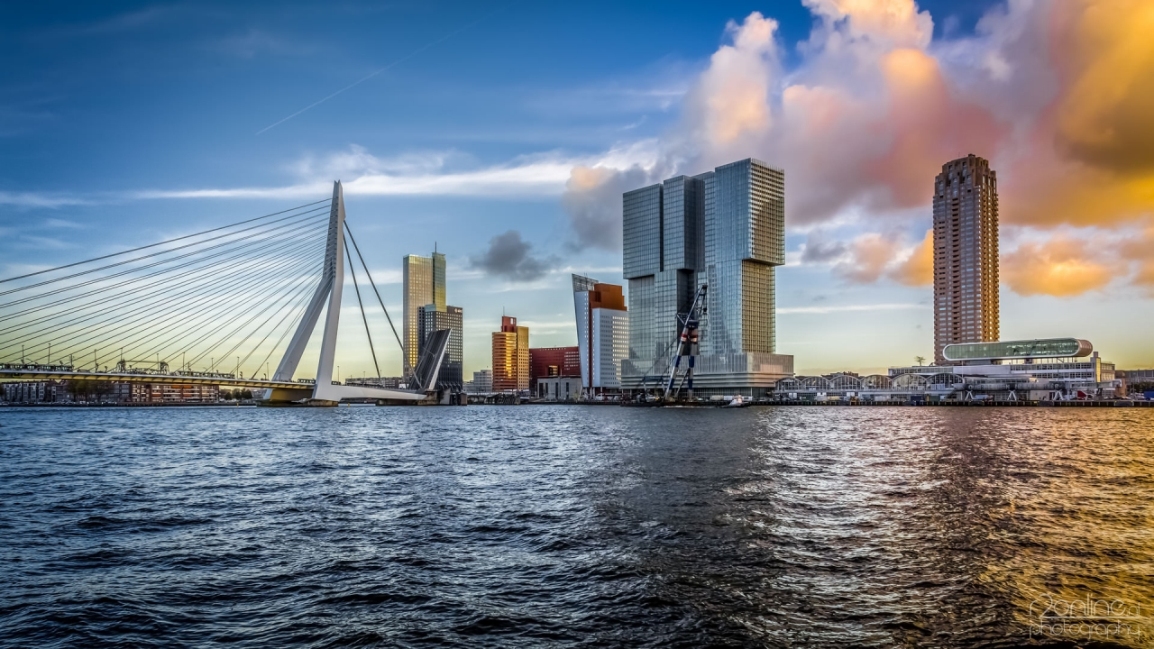

IoT
Eldert Grootenboer
Integration Architect

Slide 2
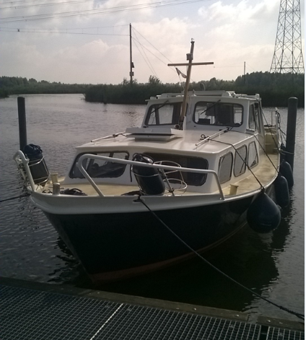
Eldert Grootenboer
Integration Architect
Microsoft Azure MVP
SME IoT
Blogger
Published Author
International Speaker
Technet / MSDN
Boat enthusiast

Slide 3
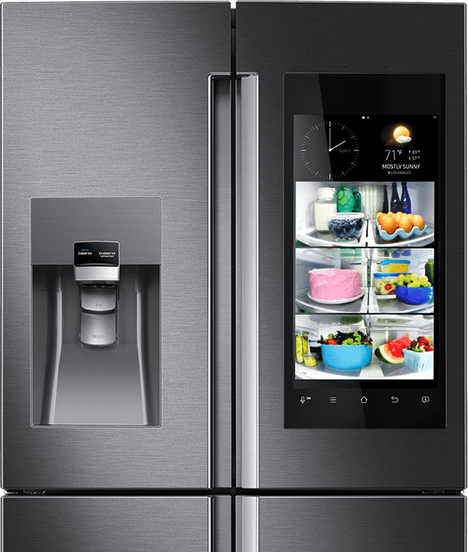
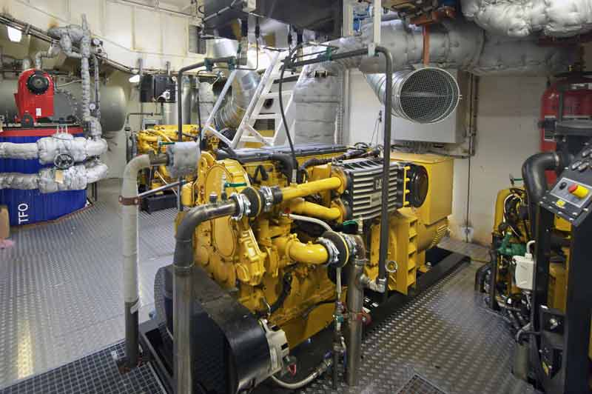
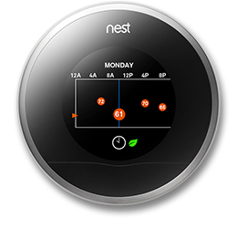

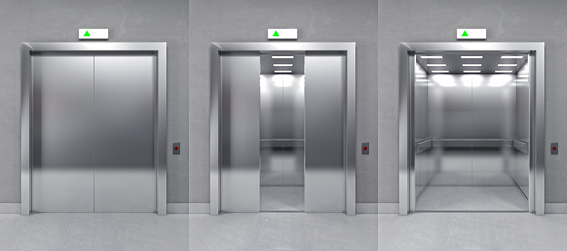
Everything Gets Connected

Slide 4
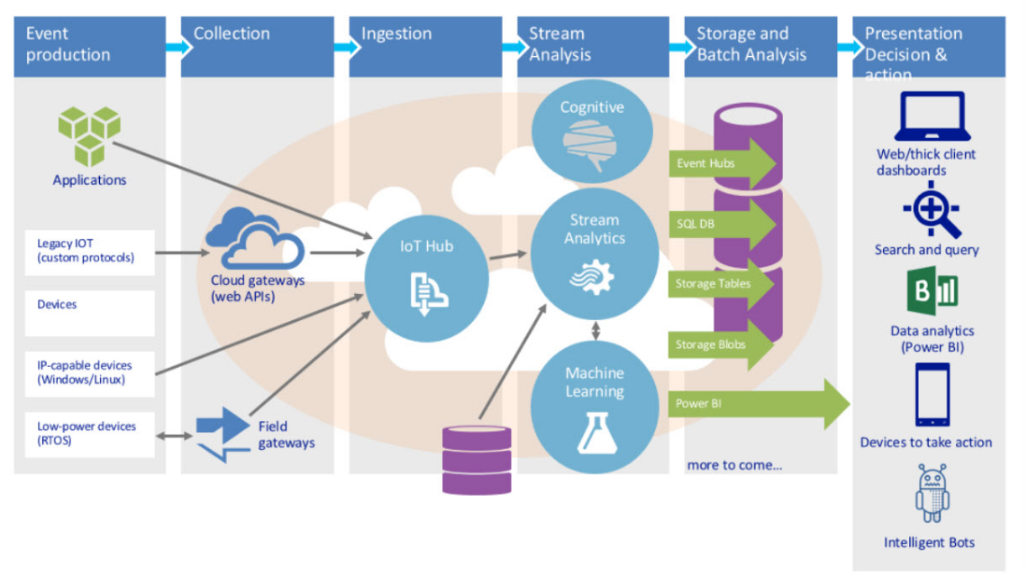
IoT Architecture

Slide 5
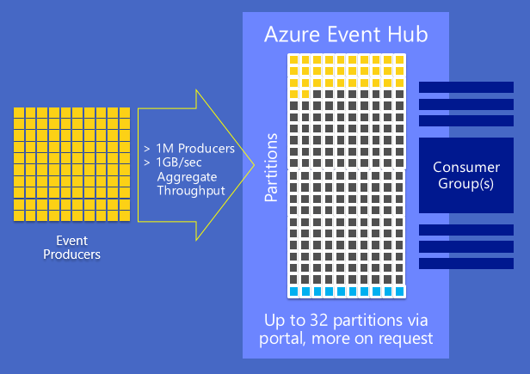
Event Hubs

Slide 6
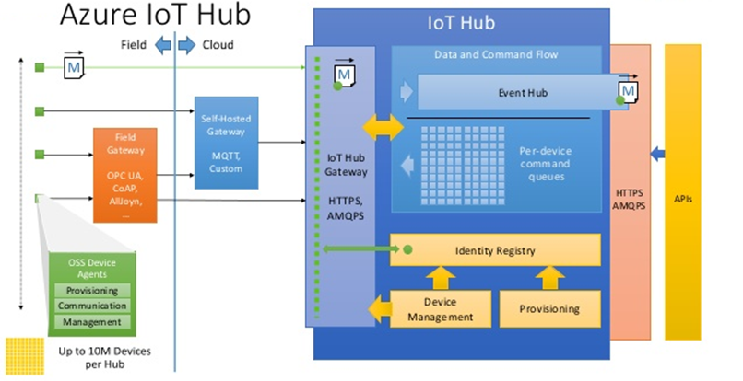
IoT Hub
Notes:
Registration
Management
Device to Cloud
Cloud To Device
EventHubs
Routes

Slide 7
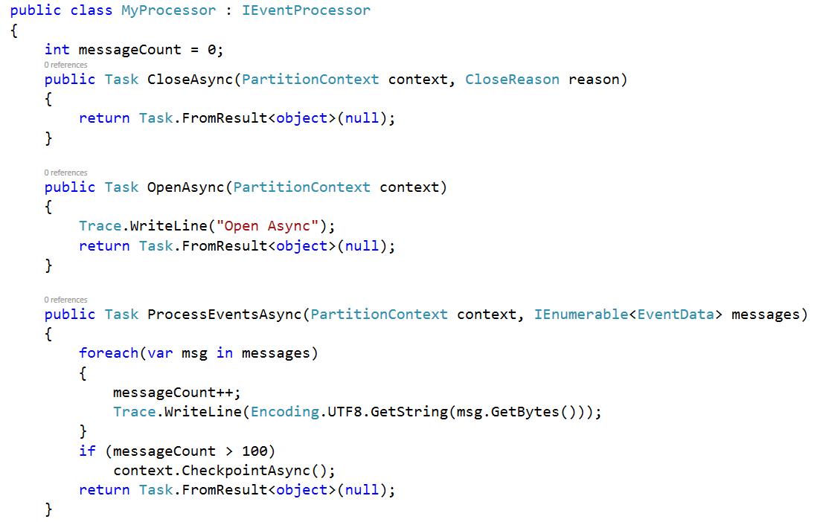
Event Processor Host

Slide 8
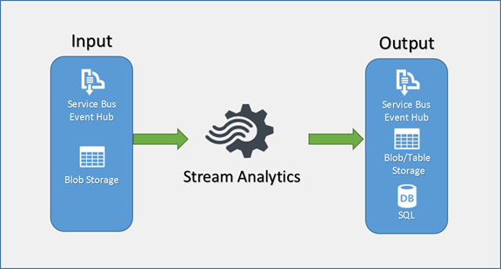
Stream Analytics

Slide 9
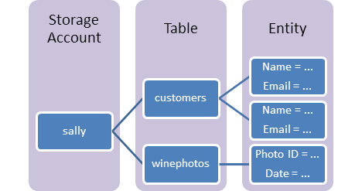
Table Storage

Slide 10
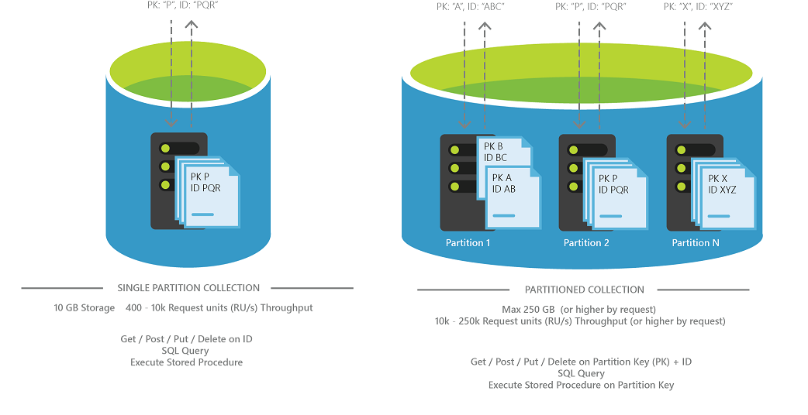
DocumentDB

Slide 11
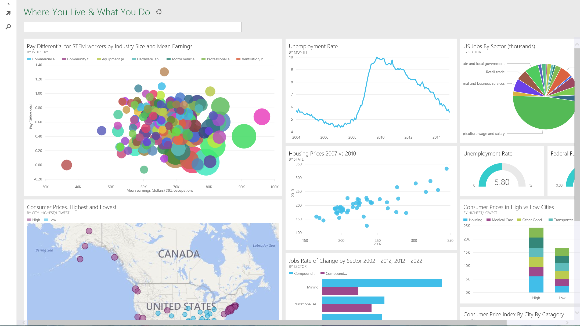
PowerBI

Slide 12
Demo

Slide 13
Key Takeaways
Quick
Quick time to market
Scalability
Extremely scalable, which is what IoT needs

Slide 14



Thank You
@egrootenboer
eldert.grootenboer@motion10.com
http://blog.eldert.net/

Slide 15




Think
Share
Move

